Slide 1
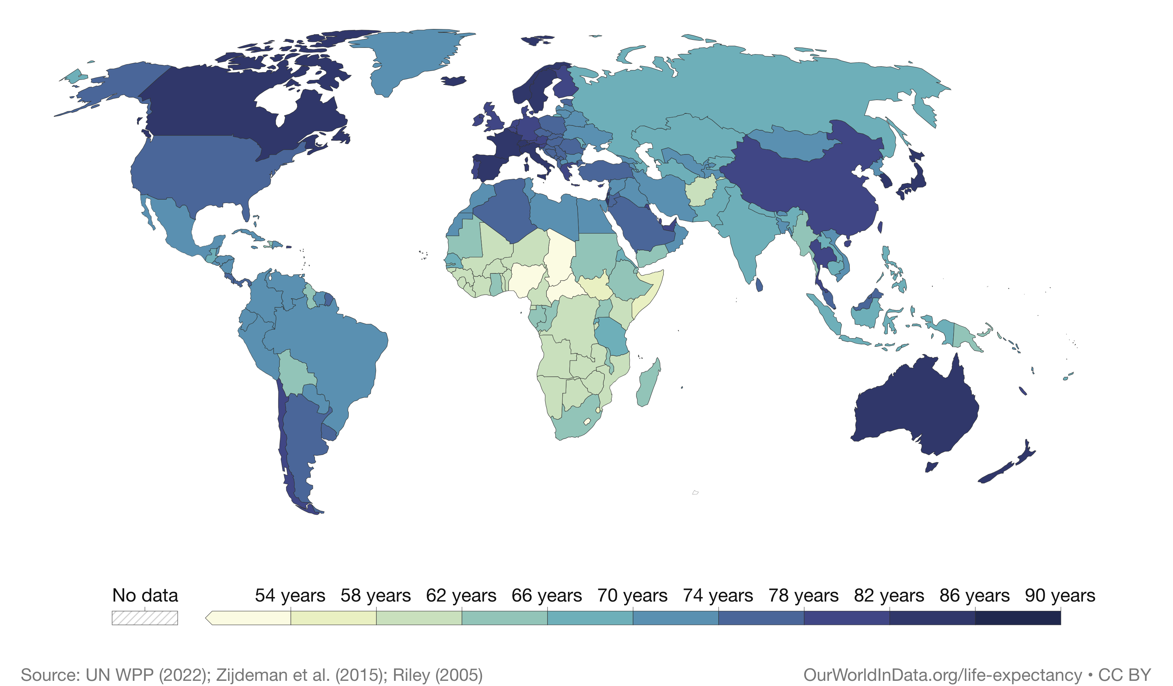
Predicting Life Expectancy
Dana McGowan
Brown University Data Science Initiative
October 17, 2023
https://github.com/danamcgowan/Data1030-LifeExpProject.git

Slide 2
Project Introduction
The problem: Life expectancy has been studied immensely, but not heavily as it relates to factors that governments can affect.
Can the average life expectancy of a previously unseen country be predicted using immunization and human development index data?
What government effected factors contribute to the increases/decreases of life expectancy?
Regression Problem
Data
Pulled from Kaggle – Collected by World Health Organization (WHO) and United Nations Website
2,938 data points and 22 features
193 countries from 2000-2015

Slide 3
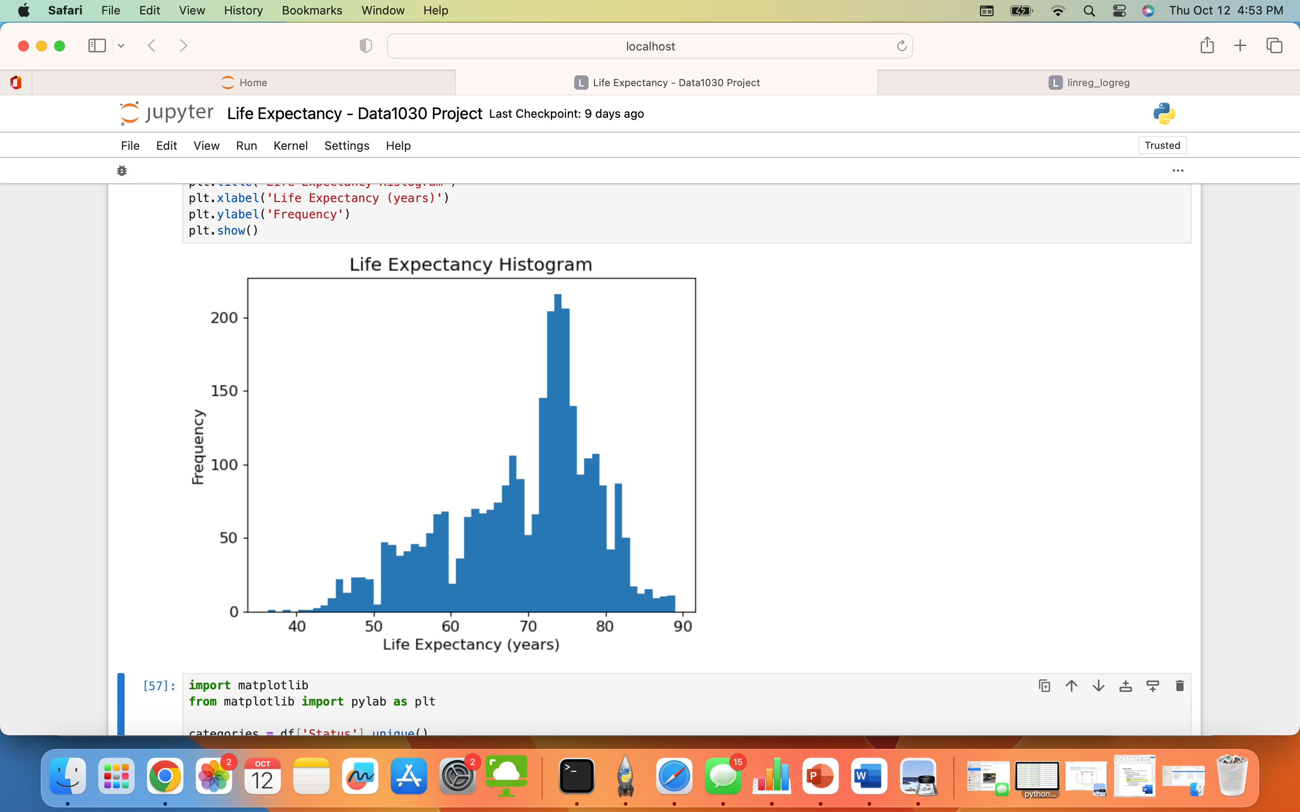
Exploratory Data Analysis

Slide 4
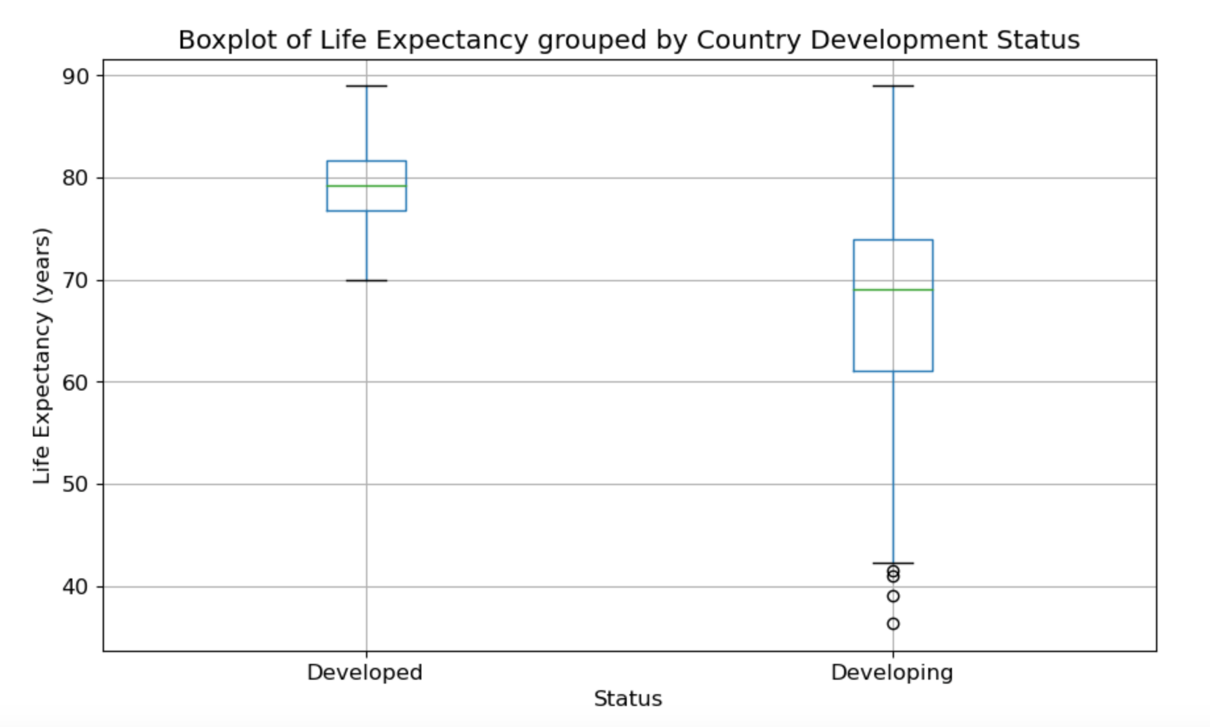
Exploratory Data Analysis

Slide 5
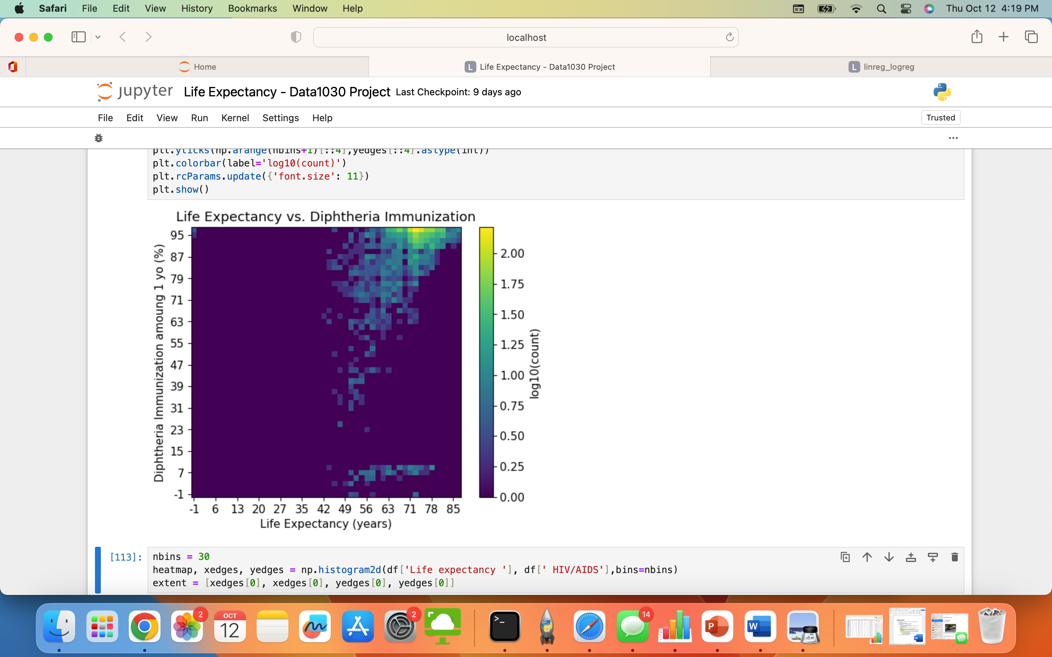
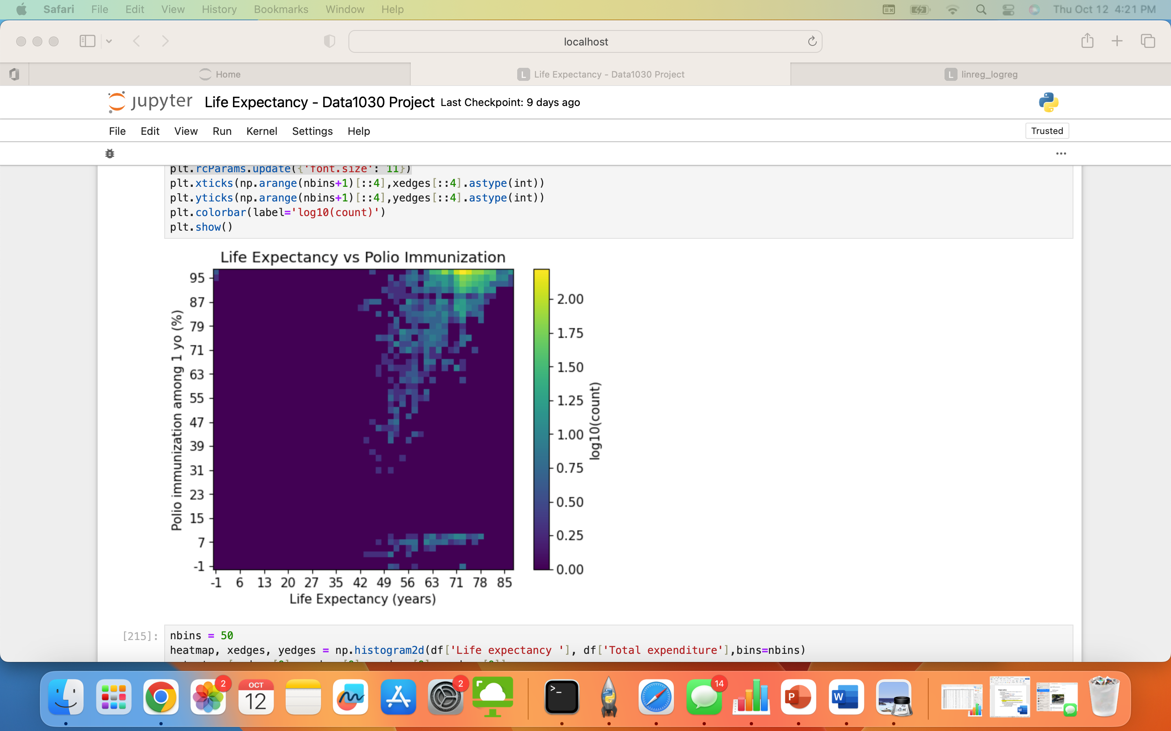
Exploratory Data Analysis

Slide 6
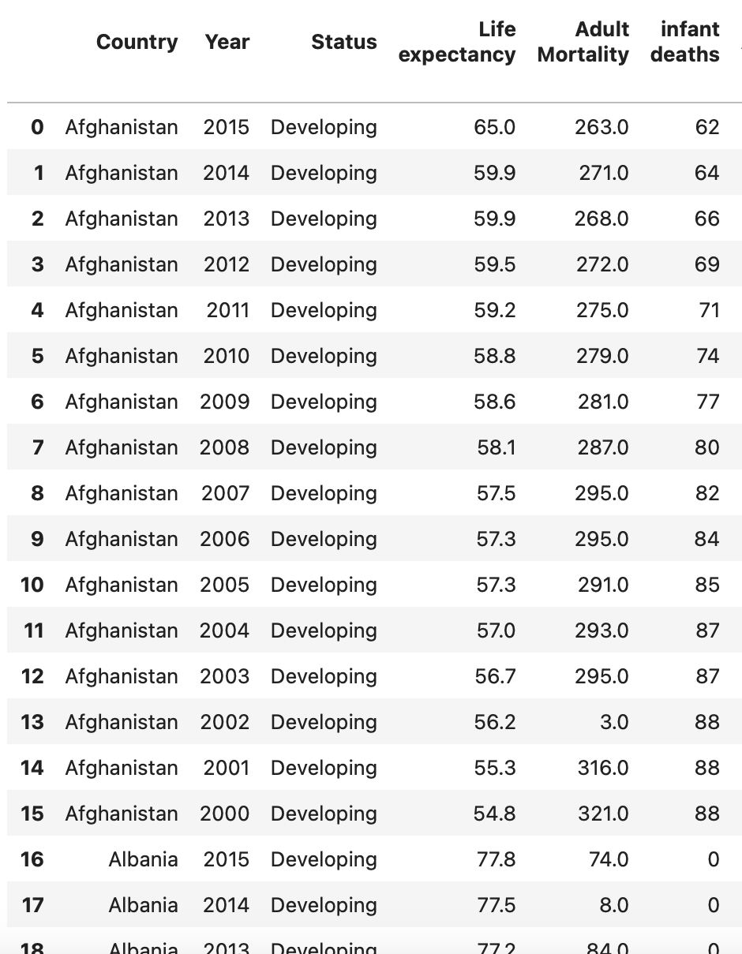
Splitting Data
Group Shuffle Split
Training size set to 0.8
Group K Fold
K = 4
Final Groups:
Training Set – 1,764 rows and 21 columns
Validation Set – 580 rows and 21 columns
Test Set – 594 rows and 21 columns

Slide 7
Preprocessing
Preprocessors
One Hot Encoder – Country and Status
Standard Scaler – all other features
Shape of Data
Before Preprocessing:
Training Set: 1,764 rows and 21 columns
Validation Set - 580 rows and 21 columns
Test Set – 594 rows and 21 columns
After Preprocessing:
Training Set: 1,764 rows and 113 columns
Validation Set - 580 rows and 113 columns
Test Set – 594 rows and 113 columns

Slide 8
missing Values
43.9% of the points have missing values
63.6% of features have missing values. Features with missing values include:
Life expectancy
Adult Mortality
Alcohol
Hepatitis B
BMI
Polio
Total expenditure
Diphtheria
GDP
Population
Thinness 1-19 years
Thinness 5-9 years
Income composition of resources
Schooling

Slide 9
Questions

